Slide 1
Teach in Taiwan Orientation
Foreign English Teacher(FET)
in Taoyuan
Presenter : Eshan Chang

Slide 2
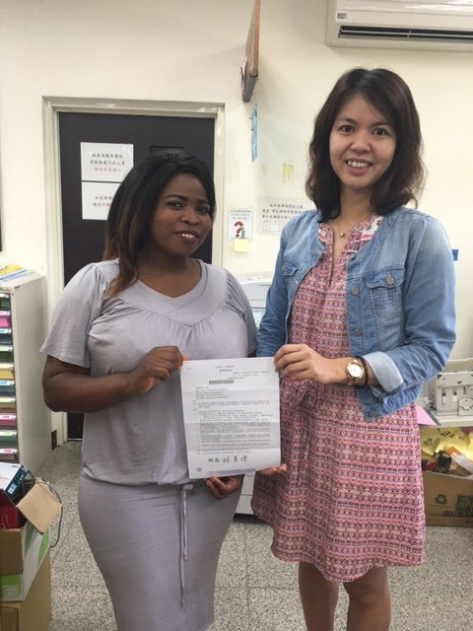
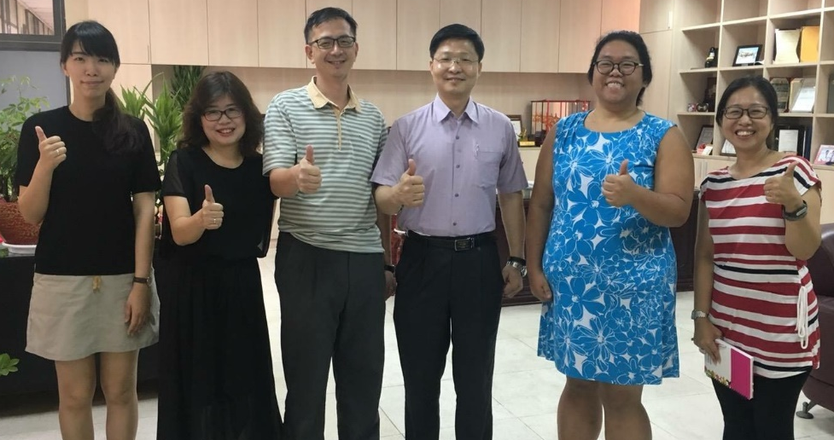
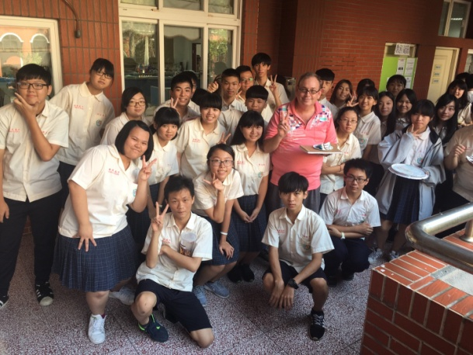
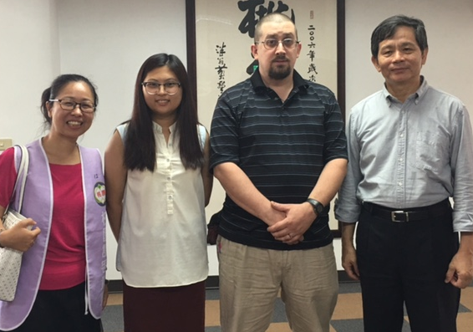
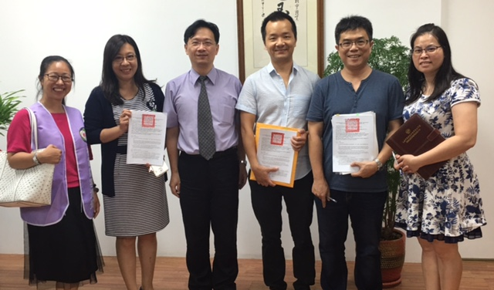
Teacher Introduction
Siligugu Mkhize
Caitlin Lim
Edwin Moore
Gregory Belback
James Chen

Slide 3
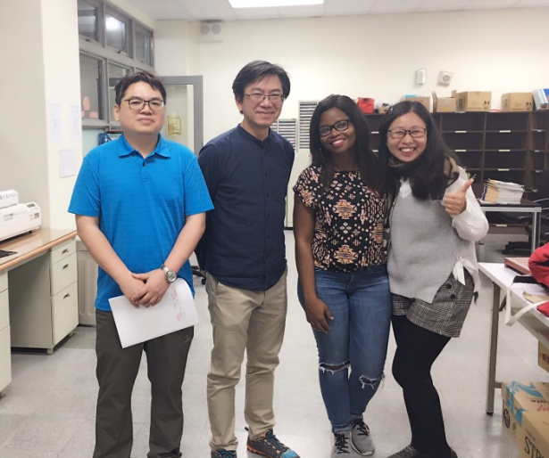
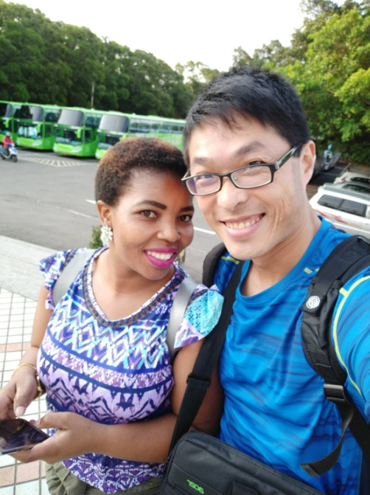
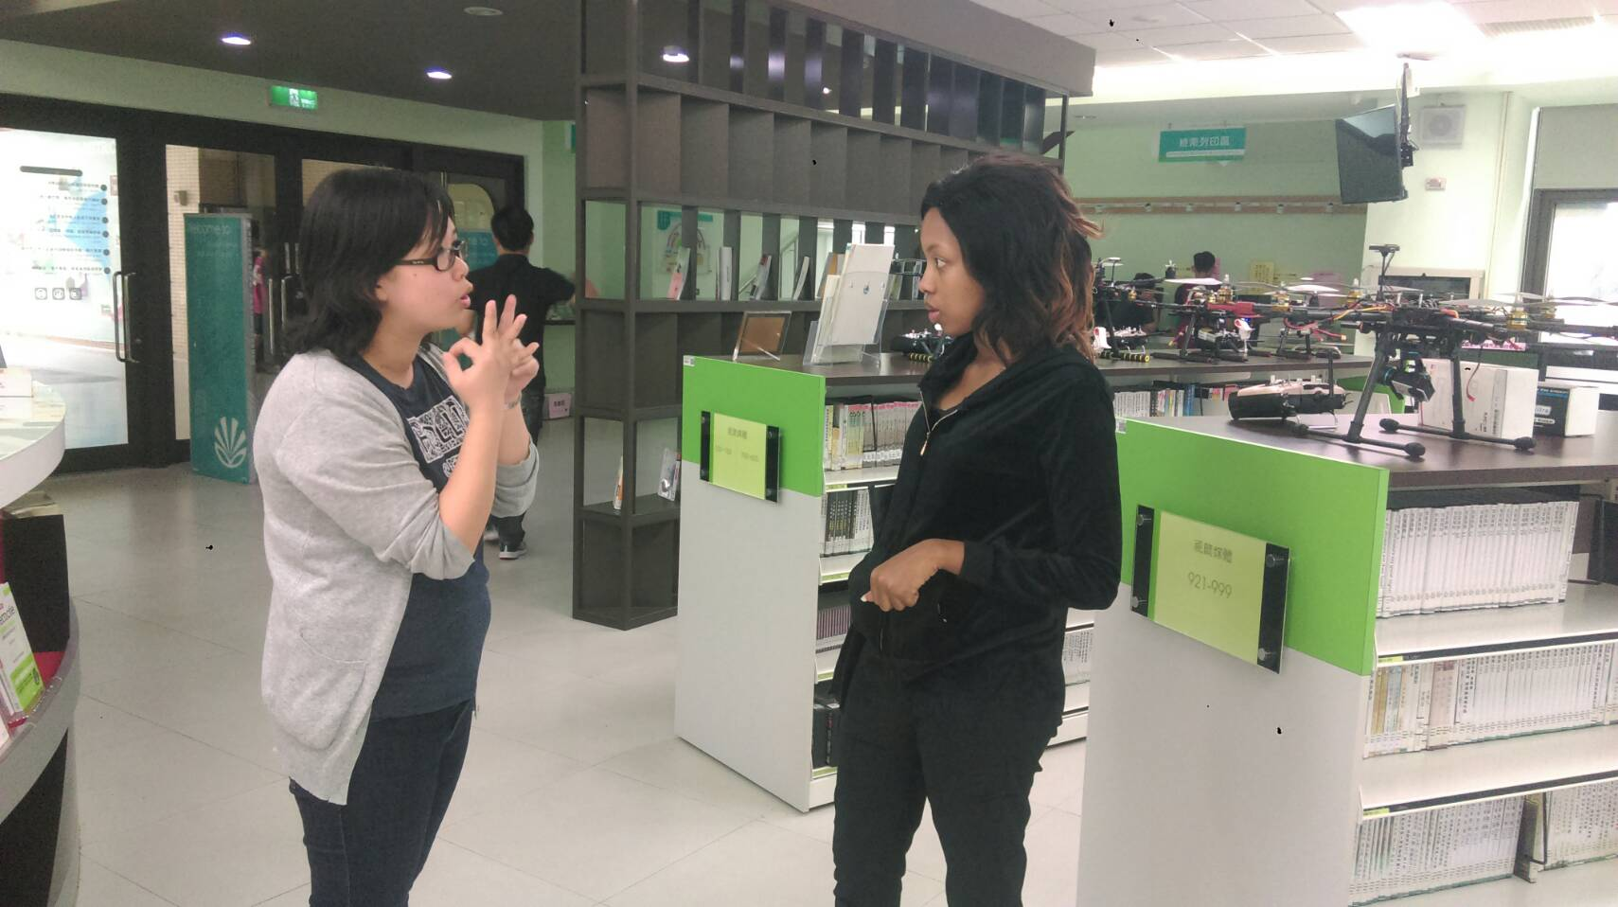
New teacher Introduction
Zola Msibi
Thadenka Mkhize
Sibanisethu Nxumalo

Slide 4
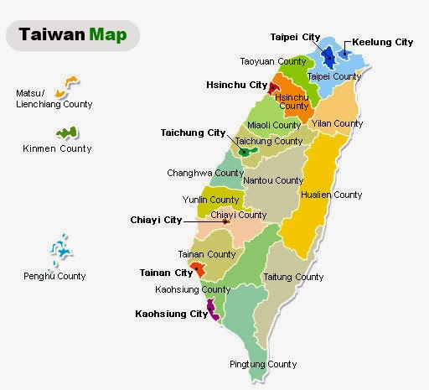
Welcome to Taiwan! Taoyuan
Taoyuan City
New Taipei City
Taiwan-The Heart of Asia
https://youtu.be/Q4UhhPa1_h4

Slide 5
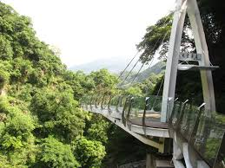
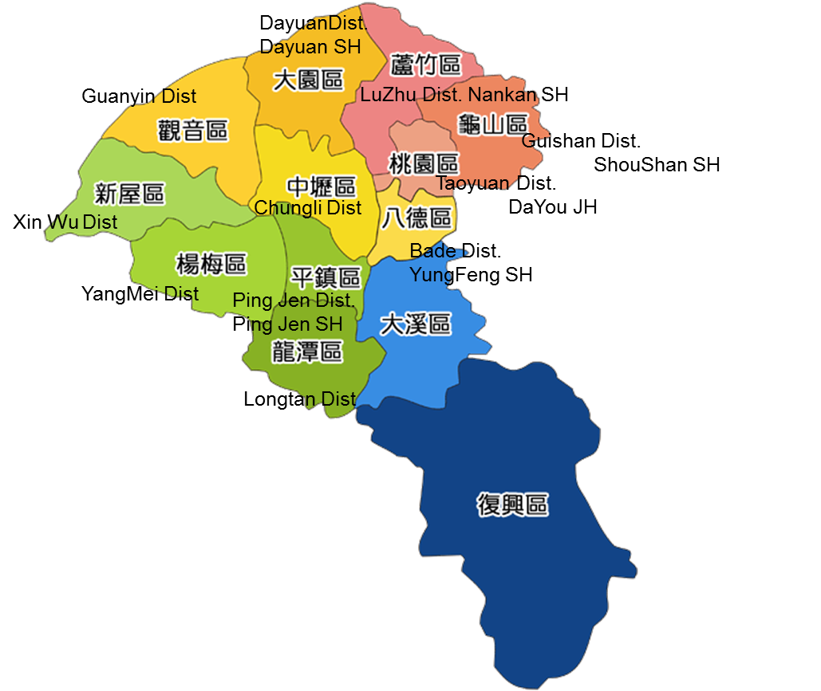
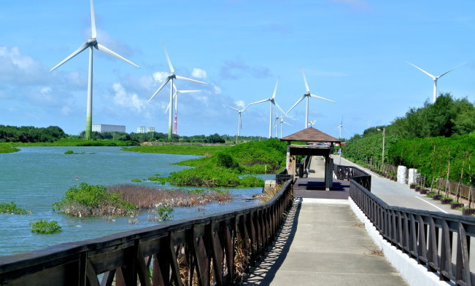
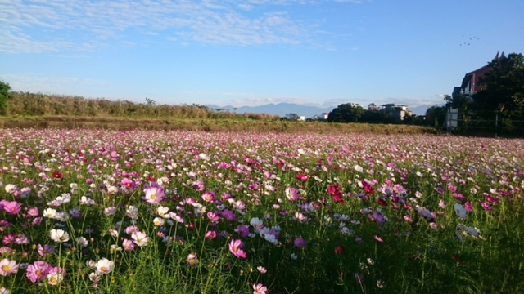
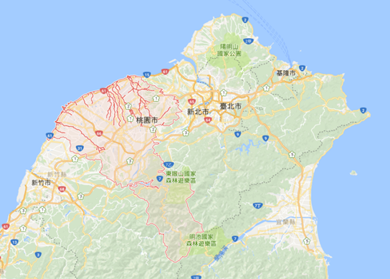
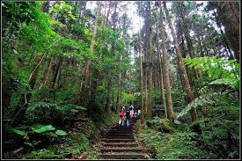
Landscape in Taoyuan

Slide 6
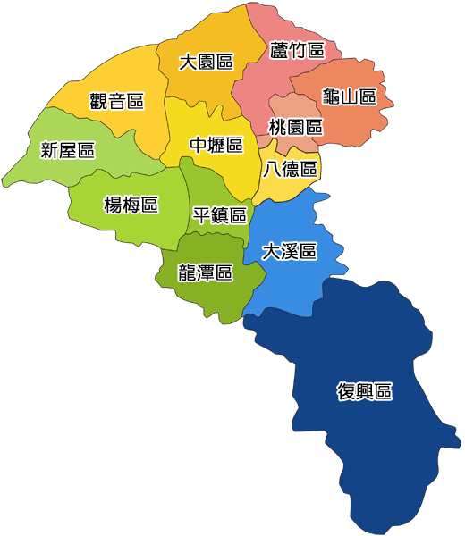
The Facts about Taoyuan
DayuanDist.
Dayuan SH
13 Districts in Taoyuan
2,500,000 people
The city with most foreign workers from East/South Asia in Taiwan
An international airport
A high speed rail station
8 municipal SH Schools
Guanyin Dist
LuZhu Dist. Nankan SH
Guishan Dist.
ShouShan SH
Taoyuan Dist.
DaYou JH
XinWu Dist
Chungli Dist
Bade Dist.
YungFeng SH
YangMei Dist
Ping Jen Dist.
Ping Jen SH
DaSi Dist.
Dasi SH
2018 Taoyuan FET Project
Shou Shan SH (central school)
Dayuan International SH
Nan Kan SH
Yung Feng SH
Ping Jen SH
Dasi SH
7. Xinwu SH
8. Guanyin SH
Longtan Dist
Fuxing Dist

Slide 7
Teach in Taiwan
Things a FET should know

Slide 8
1.Start to work in Taiwan
Step 1
Step 2
Step 3
Work Permit
Ministry of Labor
Visitor Visa
Ministry of Foreign Affairs
ARC
Immigration Department
What’s the benefit to get an ARC?
Join National Health Insurance in Taiwan
Open an Bank Account in Taiwan
It is like your Taiwanese identification

Slide 9
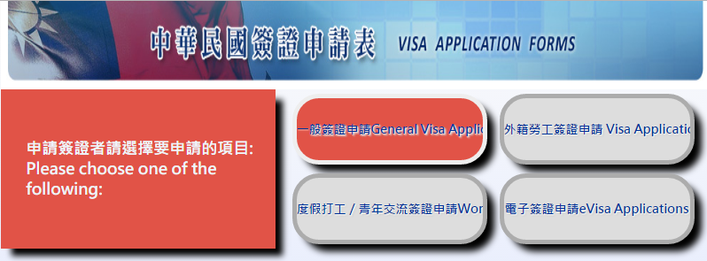
Step2: changing visa
FET need to obtain a visitor or resident visa to apply ARC
Visit the website: https://visawebapp.boca.gov.tw/

Slide 10
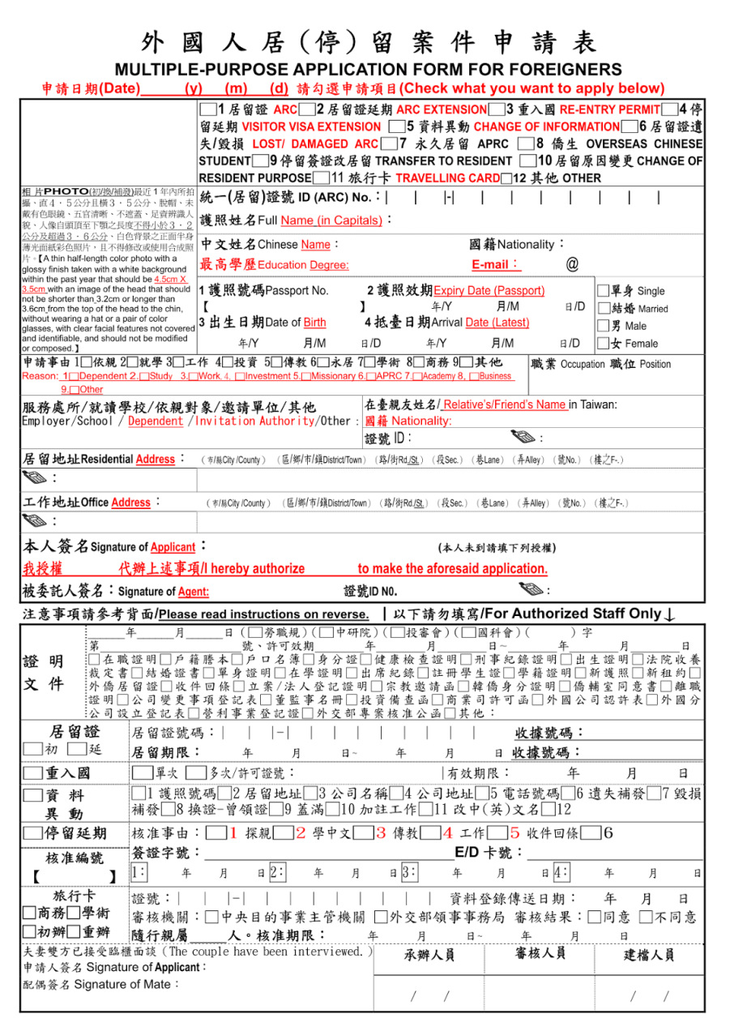
Step3: ARC (Alien Resident Certificate)
1.
2.
3.
Must be valid and correct
Passport (with visitor or resident visa)
Work Permit (original)
ID Photos
House rental contract
Fee

Slide 11
2. Labor Insurance
Quote : an amount equal to 20% of the total premium charged to him/her under the Labor Insurance Program.
Level | Salary Base | Premium
 |  | You pay 20% | Employer pay 70%
1 | 20,008 | 400 | 1,401
2 | 20,100 | 402 | 1,407
19 | 43,900 | 878 | 3,073
20 | 45,800 | 916 | 3,206
21 | 48,200 | 916 | 3,206
22 | 50,600 | 916 | 3,206
25 | 57,800 | 916 | 3,206
26 | 60,800 | 916 | 3,206
27 | 63,800 | 916 | 3,206
28 | 66,800 | 916 | 3,206
Government pay 10%
Salary base X premium rate (10%) X 20% = you pay
$45,800 X 10% = 4,580 / $4,580 * 20% = 916 (you pay)

Slide 12
3. Health Insurance
Quote : 30% of the total premium charged to him/her under the National Health Insurance Policy.
Level | Salary Base | Premium
 |  | You pay 30% | Employer pay 60%
1 | 20,008 | 282 | 906
2 | 20,100 | 283 | 911
19 | 43,900 | 618 | 1,989
20 | 45,800 | 644 | 2,075
21 | 48,200 | 678 | 2,184
26 | 60,800 | 855 | 2,755
27 | 63,800 | 898 | 2,890
28 | 66,800 | 940 | 3,026
Government pay 10%
Salary base X premium rate (4.69%) X 30% = you pay
$66,800 X 4.69% = 3,133 (premium) / $ 3,133 * 30% = 940 (you pay)

Slide 13
4. Bank Account
Ask your school for the designate bank.
Bring your ARC / Health Insurance card / passport
Deposit $1,000
ATM card with or Visa Debit card with
Apply for online banking
Foreign currency account
Online overseas transfer $ :
Country / bank name / branch / account name / account # / swift code
--- 6 items

Slide 14
5. Withholding Tax
The number of days of residence* | Withholding Tax rate
Staying LESS than 183 days | 18%
Staying MORE than 183 days | 5%
*The withholding tax rate depends on your stay in Taiwan
*In Taiwan, people file tax in May

Slide 15
6. Accommodation & Airfare Reimbursement
The one-way airfare shall be reimbursed based on the actual itinerary traveled and shall not exceed NT$ 40,000.
Provide the purchase receipt or proof of purchase, and the boarding pass (economy-class only) of flight to Taiwan within 3 months after reporting to the School
Accommodation or rent allowance： rent allowance of NTD$5000 or NT$10,000 for a teacher with a spouse/lineal relative(s) by blood per month.
FET shall provide related documents proved by school for the rent allowance.

Slide 16
7. Health Exam & Background Check
Get a General Health Check
plus a Chest X –ray
Get a background check
*Medical report should be within 6 months
Contract article 3.11

Slide 17
8. Take Leave
Quote:Party B shall abide by the relevant rules and regulations adopted by Appendix D and E with regards to any leaves taken by Party B.
Personal : XX days in advance
Injury : Contact your head teacher or PM(Eshan)
Sick : Contact your head teacher
Others : by the contract

Slide 18
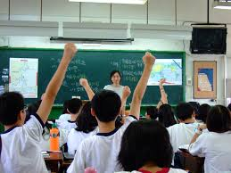
9.Terms & Conditions
Party B(FET) agrees the Department of Education of Taoyuan City Government and schools have the right to make use of videotapes and photographs while FETs is teaching or taking part in school activities. (article 3.10)
Schools have the right to examine FET’s teaching plan, reflection and self-evaluation. In addition, FETs, depending on actual requirements, shall receive teaching supervision by the Department of Education of Taoyuan City.

Slide 19
Senior High School structure outlook
Principal Office
Secretary
Academic Affairs Office
Students Affairs Office
General Affairs Office
Counseling
Personnel/
Accounting
Library

Slide 20
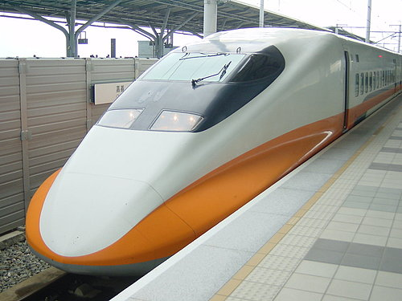
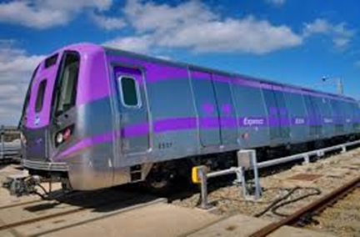
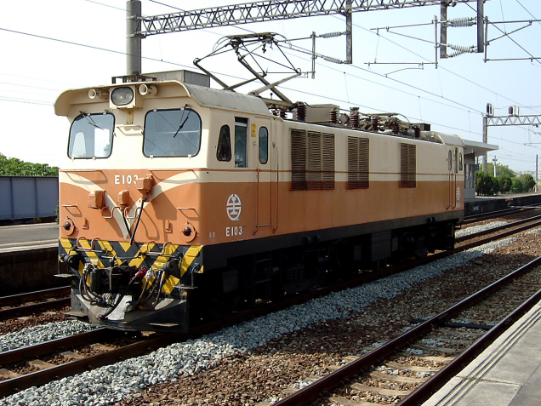
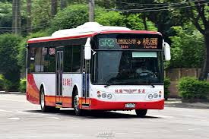
Useful Info about Taoyuan
-Public Transportation-
1. High Speed Rail
2. Taoyuan Airport MRT(Mass rapid transit)
3. Train
4. Bus

Slide 21
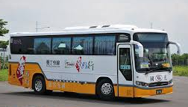
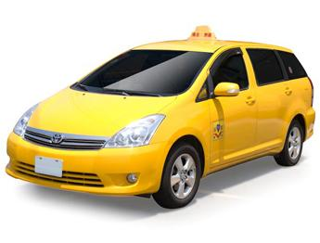
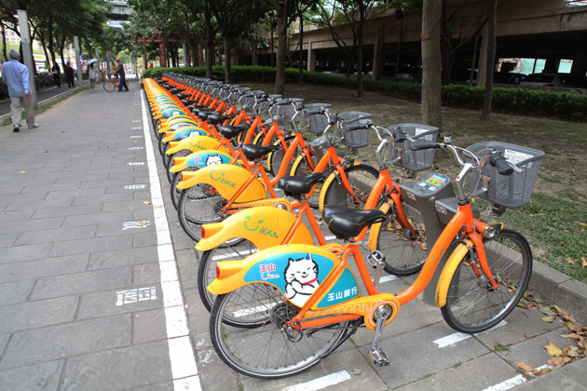
Transportation in Taoyuan
Taiwan Tourist Shuttle
Taxi
UBike

Slide 22
An easy Life with Easy Card
*Where to get one?
-Convenience Stores or Metro/Bus station
*How to use it?
-Deposit NTD.100 and top up the amount you like
-Payment in convenience stores (7-11/family mart)
-Payment for public transportation in Taoyuan & Taipei (Bus/Train/some taxi might accept it
*Not include HSR(High speed rail))
-Payment for some public parking service in Taipei
-U bike (need to registered online first)

Slide 23
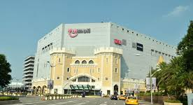
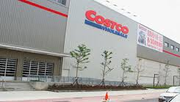
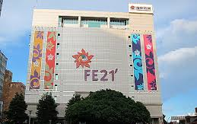
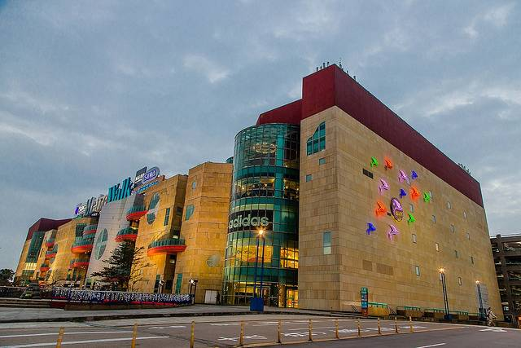
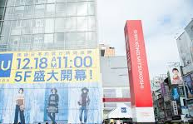
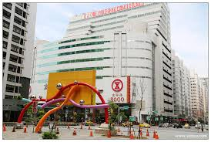
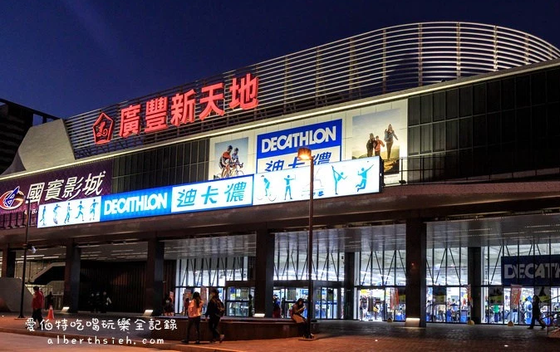
Shopping?
TaiMall in Nankan
COSTCOin Nankan &
Zhongli
FE 21 & ShinKong Mitsukoshi in Taoyuan
Metro Walk Dayuan
IKEA in Nankan
SOGO in Zhongli
KWONGFONG PLAZA in Bade

Slide 24
Shopping for groceries?
Supermarkets & convenience stores

Slide 25
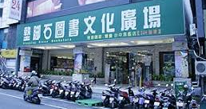
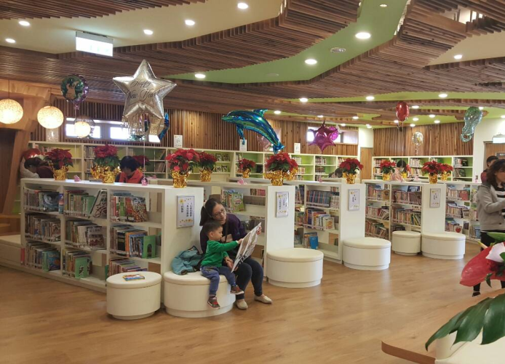
Books?
Library in school or public library
Stationery?

Slide 26
Observe the difference in Taiwan
No tap water.
Unavailable to flush used tissue at some place.
Have food outside is popular.
Jump up and throw your rubbish while hearing a beautiful melody “A maiden’s pray”.
Do not forget bringing a bag with you when going to buy necessity
Can do hitchhiking gesture to yellow cars but you need to pay. Taxi is yellow one.
You must put on a helmet when you are on a scooter.

Slide 27
Live in Taiwan
Tourism Information (by Tourism Bureau, ROC)
http://eng.taiwan.net.tw/
Let’s Learn Chinese (by Overseas Community Affairs Council,ROC)
http://www.huayuworld.org/

